Slide 1
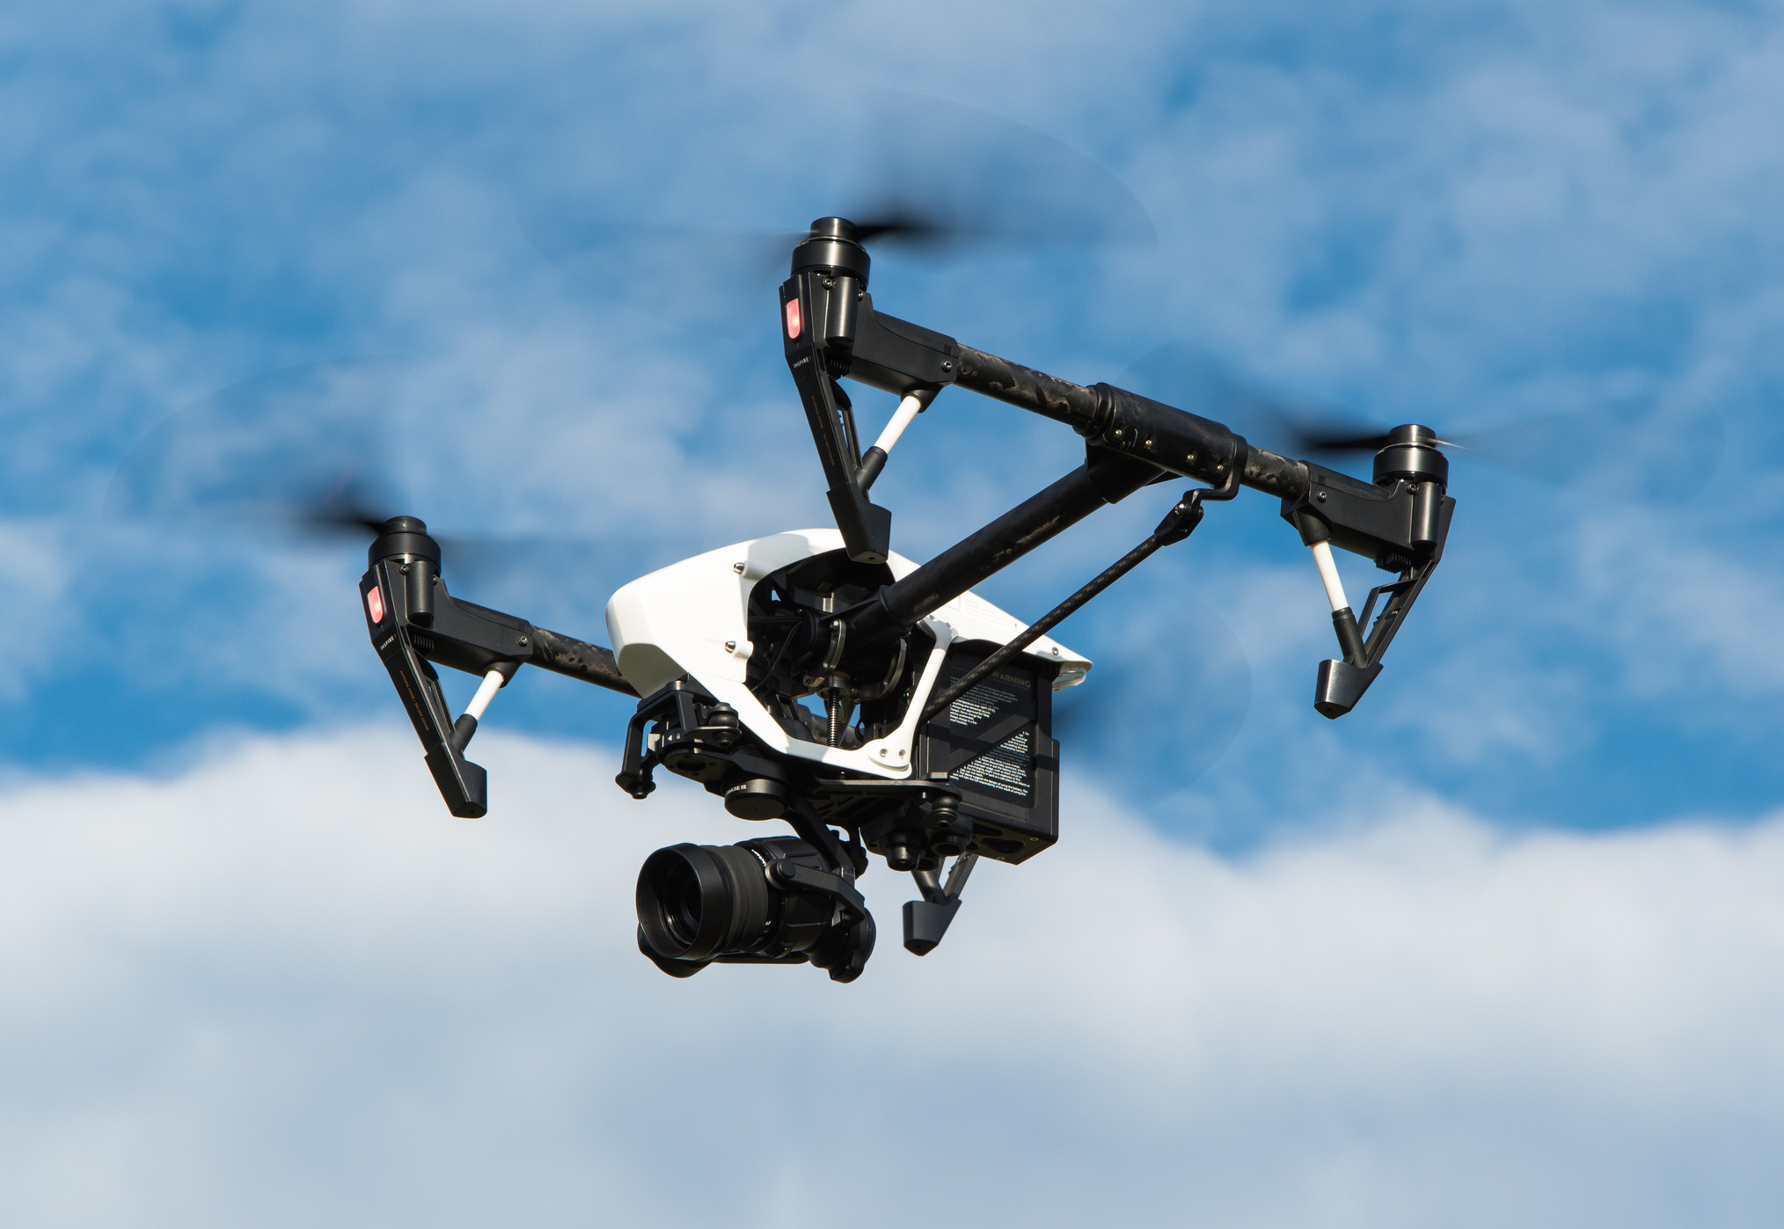




CHANDIGARH UNIVERSITY
SPYDER-AN AUTONOMOUS DELIVERY DRONE
Tekathon 2.0
A Student Innovation Project
PRESENTED BY
The Geek Squad

Slide 2



OBJECTIVES
Develop an autonomous drone capable of executing specific tasks, such as deliveries, with minimal human intervention.
Create a drone designed for direct package delivery from a central hub or warehouse to end-users.
Incorporate an intelligent processing unit into the drone to enable seamless communication among its various components.
Equip the drone with a variety of sensors and advanced algorithms to detect and avoid obstacles, ensuring stable flight.
Enable the drone to make real-time decisions independently by utilizing autonomous algorithms.
Ensure compliance with a range of regulatory requirements, including safety standards, privacy laws, and airspace restrictions.
Guarantee that the drone adheres to all applicable regulations for safe and legal operation.
Back to Agenda
04

Slide 3
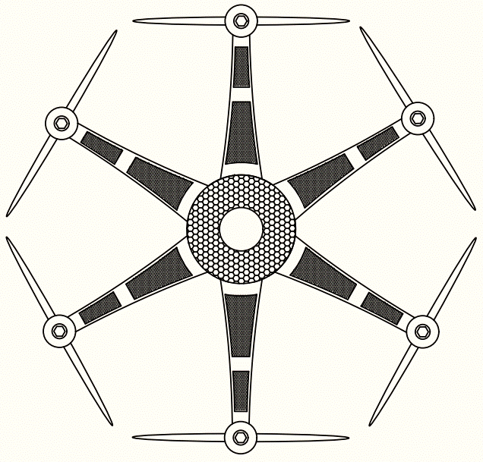
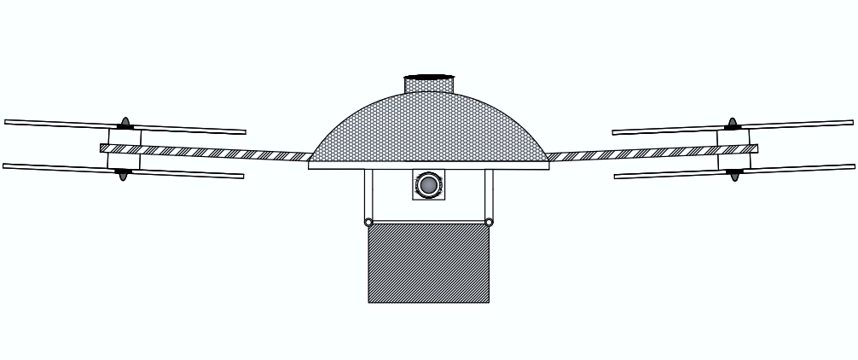
FEATURES
Autonomous Takeoff and Landing Safety Protocols for Malfunction/Failure Switch Real-Time Obstacle Detection and Avoidance Comprehensive Component Protection Hub System Integration Aerial Photography and Surveillance Seamless User Experience
05

Slide 4


